Slide 1
Trailers
  They are one-point hitch implements.
  They are used for transportation of goods.
  Small ones have two wheels while big ones have four wheels.

Slide 2
Plough
They are primary tillage implements.
The common type of ploughs include:
1.Disc ploughs.
2.Mould board ploughs.

Slide 3
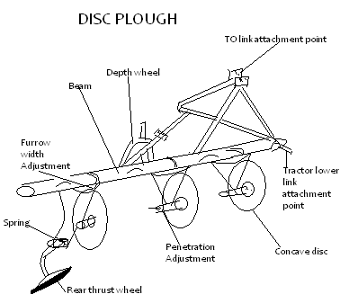
Disc plough

Slide 4
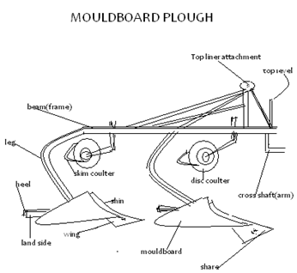
Mouldboard plough

Slide 5
Adjustment on a mouldboard plough
Depth: Controlled by raising or lowering the depth wheel.
Controlled by hydraulic control lever setting.
Pitch: controlled by altering the length of the top link.
Front furrow width: Controlled by cross shaft adjustment lever or by rotating the cross shaft crank.
Lateral levelling: Controlled by tractor lift rod.

